Slide 1

How can NHS IMAS members contribute to the NHS’s digital and data transformation?
13th October 2022
By: Simon Branston MA FCIPD

Slide 2
Agenda
1. A welcome and introduction (3 mins)
2. An overview of delivering digital and data transformations and what this now means with this years’ three key system calls to action: (12 mins)
A plan for digital health and social care
Data saves lives: reshaping health and social care with data
Better, broader, safer: using health data for research and analysis
3. A facilitated session on how NHS IMAS members can add value (40 mins)
4. A summary & close (5 mins)

Slide 3
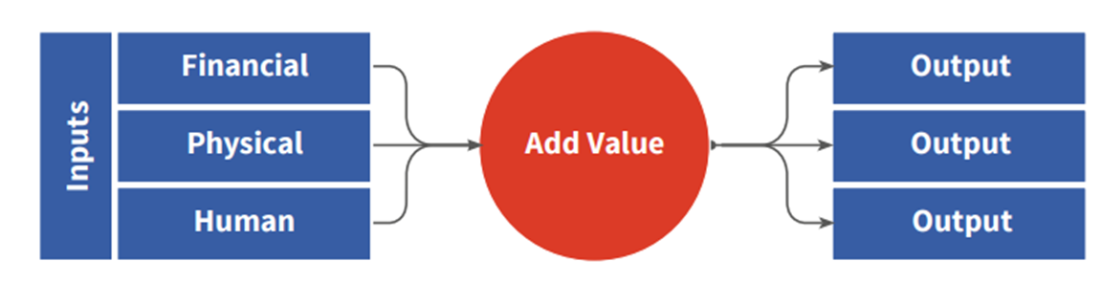
What is transformation?
© Simon Branston Ltd 2017

Slide 4
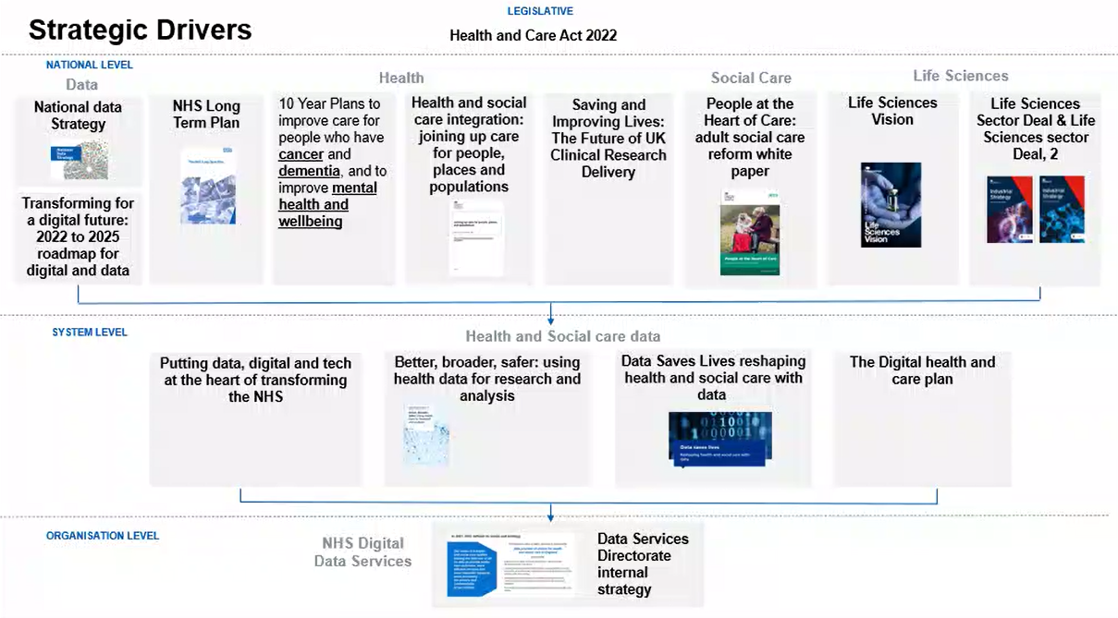

Slide 5
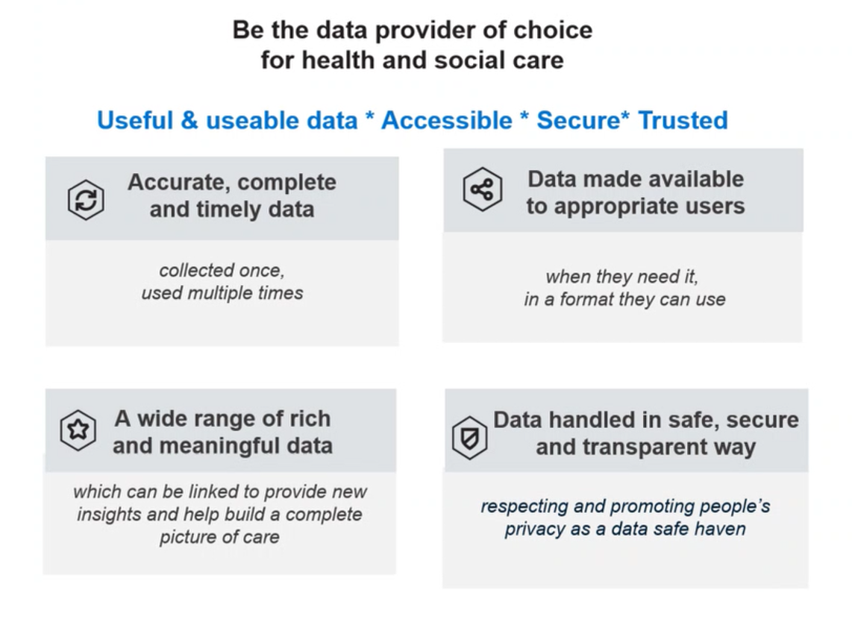
What does this mean for delivering digital & data transformation?

Slide 6
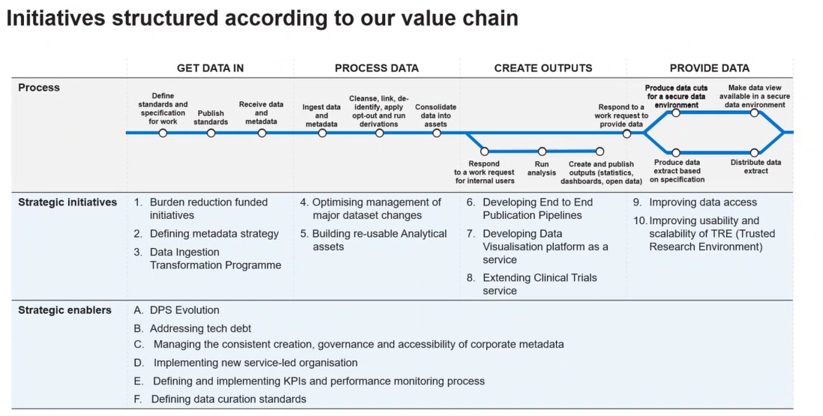

Slide 7
How can NHS IMAS members add value?

